Slide 1


Machine Learning 2 Project:
Rossmann Store Sales Forecasting
Presenters - Jake, Adil, Zihan, Ivy

Slide 2




Introductions
Jake Arendsen
Adil A Kumar
Zihan Wang
Ivy Zhou

Slide 3
Agenda
Data Preparation
Prepare the data for
modeling
Model Building Process
Business Understanding
Brief introduction of the business problem and understanding
Data Understanding
Skim through the data
Exploratory Data Analysis
Data mining for crucial insights
Data Preparation
Prepare the data for
modeling
Modeling
Overview
Overview of approach, results and final model
Evaluation
&
Deployment

Slide 4

Business Understanding

Slide 5
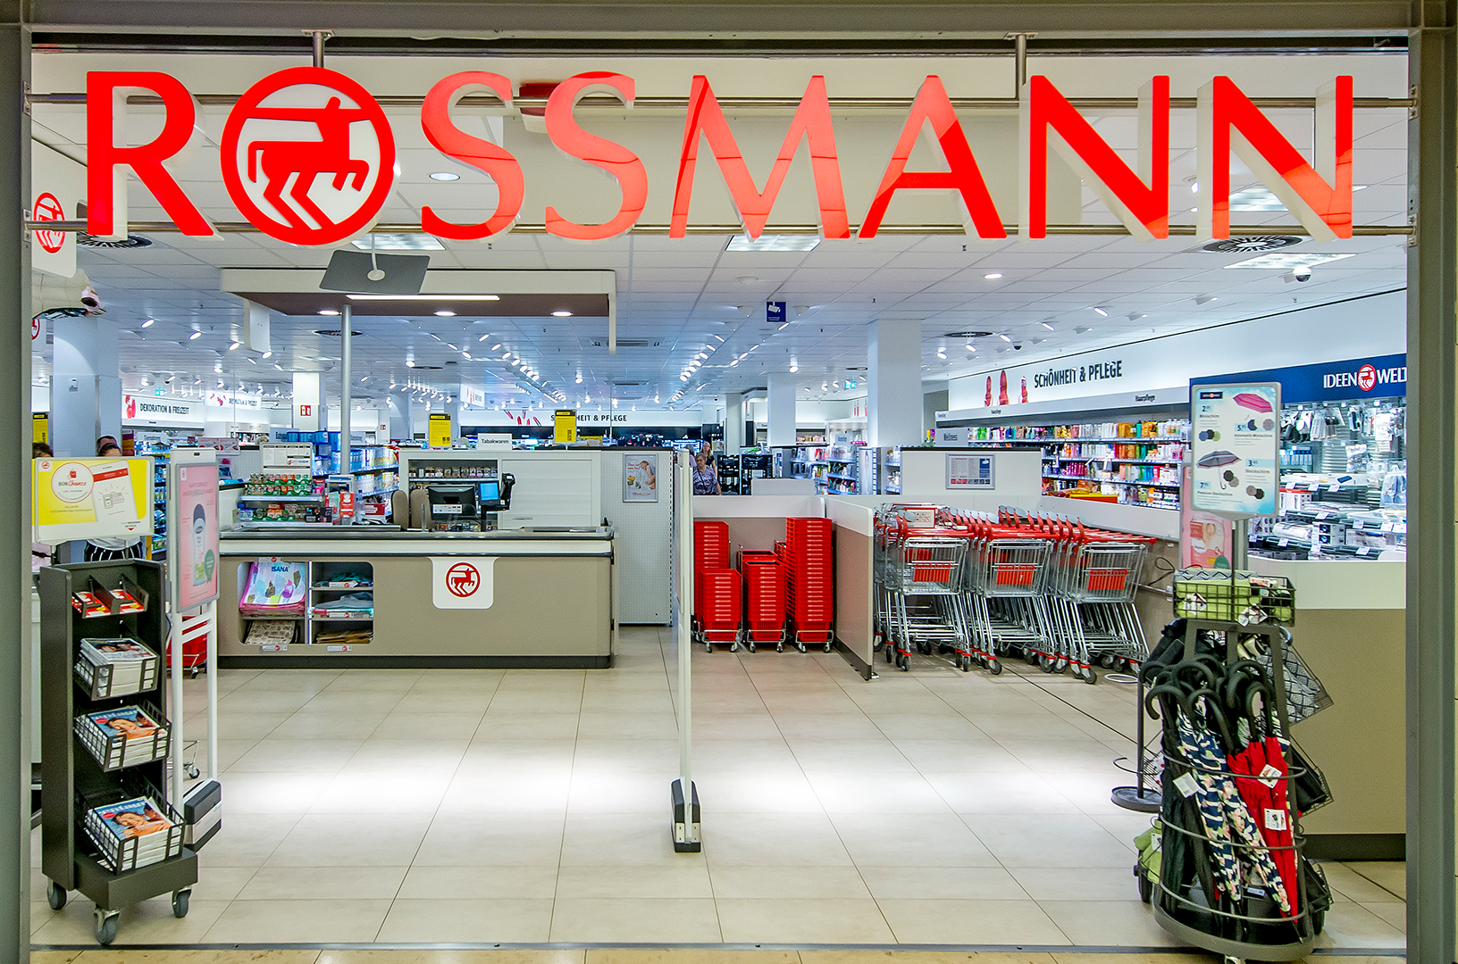
Business Understanding
Rossmann, Germany’s second-largest drug store chain that currently operates over 3,790 stores across Europe.
Client
Problem
Previously, all managers predict the sales on their own. Thus, Rossmann receives all kinds of wildly inaccurate predictions based upon numerous different factors.
Notes:
Like cvs in the us
Drug stores are wayyyyyyyyyyy different in Europe, more like what you’d think of with “convenience stores”

Slide 6

Business Understanding
Goal
Generate a centralized model that can be used to predict daily sales at a individual store level up to six weeks in advance
Sales are heavily influenced by combinations of promotions, competition, school and state holidays, seasonality, and locality
Unique circumstances for each store
Accuracy fluctuates
Challenges

Slide 7
Data Understanding

Slide 8




Data Overview
Data Files
Two Files: Sales data and Store Data
Record Detail
Sales Data: Each record includes daily Sales, Customers Visited and Promo/Holiday information for a store
Store Data: Each record describes a store in terms of Assortment, Competition and Long term Promo attributes
Variables
Dependent Variable: “Sales”
17 Independent Variables
Data Size
Over 1 million rows of Sales data for 1,115 stores for Jan 2013-July 2015

Slide 9
Variable Overview
Assortment - describes an assortment level: a = basic, b = extra, c = extended
Store Information
StoreType - differentiates between 4 different store models: a, b, c, d
Customers - the number of customers visited on a given day
StateHoliday - indicates a state holiday
Holiday
SchoolHoliday - indicates if the store was affected by the closure of public schools
Variables
CompetitionDistance - distance in meters to the nearest competitor store
Competition
CompetitionOpenSince[Month/Year] - gives the approximate year and month of the time the nearest competitor was opened
Promo - indicates whether a store is running a promo on that day
Promo2 - Promo2 is a continuing and consecutive promotion for some stores
Promotion
Promo2Since - describes the year&week the store started participating in Promo2
PromoInterval - describes the consecutive intervals Promo2 was in place

Slide 10
Exploratory Data Analysis

Slide 11
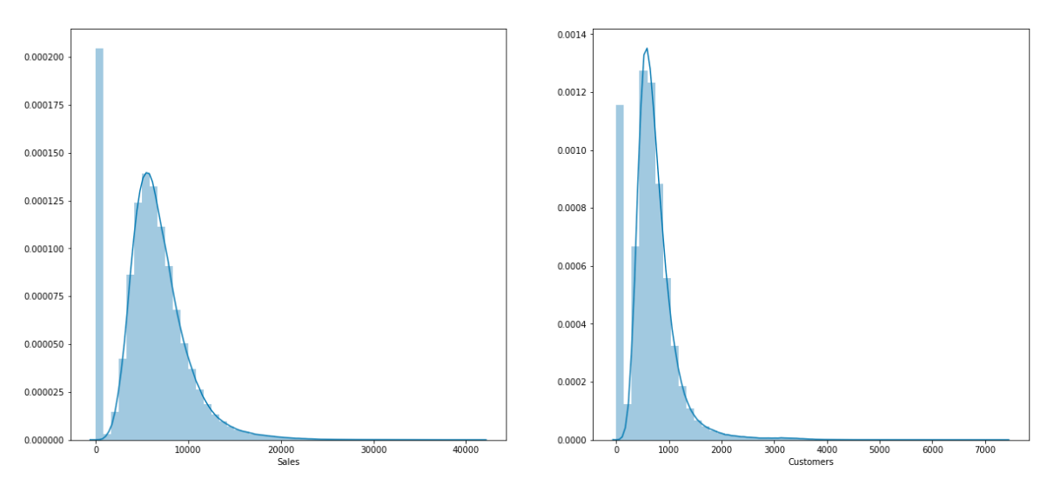
Variables Need Transformation
Distributions of numeric variables are heavily right skewed
Large numbers should be treated as legit records instead of outliers
Consistency between the sales and the number of customers, especially on promotion days
Power transformation for normally distributed attributes
Logarithm, square, cube to transform
Histogram, Q-Q plot, and skewness to check
Sales
Customers

Slide 12
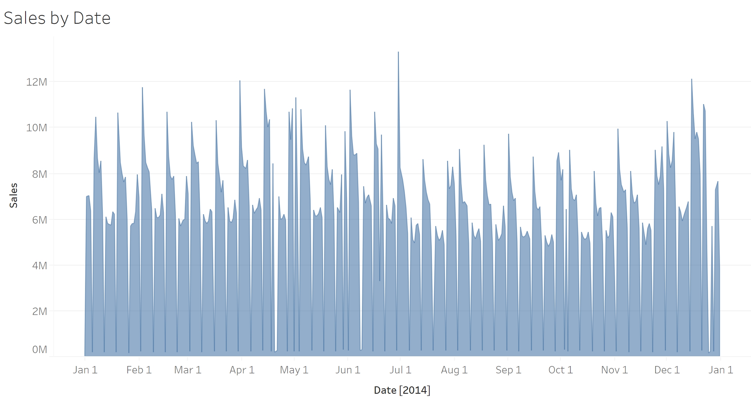
Consistent Weekly Sales trends
Variation makes it challenging to predict
Repeating dips resulted from extremely low sales on Sunday
3 lows in Sales- late April, early June, and late December - are national holidays (Easter, Whit Monday, and Christmas)
An overall consistent up-and-down trend in a one-year period, what about a shorter period?
Sales by Date

Slide 13
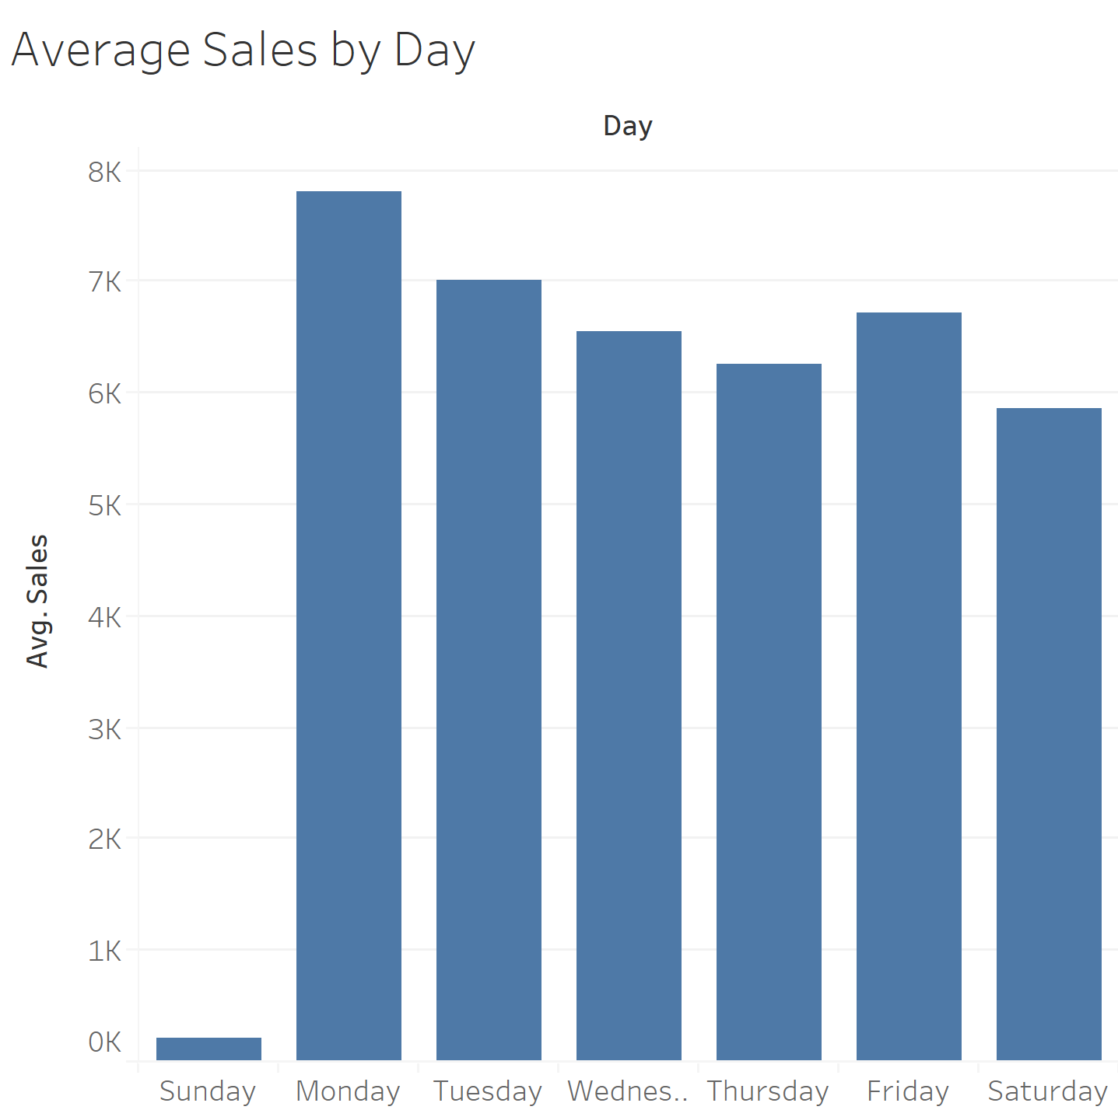
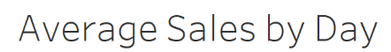
Sunday vs. Rest of the week
Low sales on Sunday due to store closing, which might lead to the increases of sales on Monday
A slowly decreasing trend overall expect for a jump of sale on Friday, when people are likely to do some extra shopping to avoid shopping on weekend
Such observation might not be consistent across all weeks

Slide 14
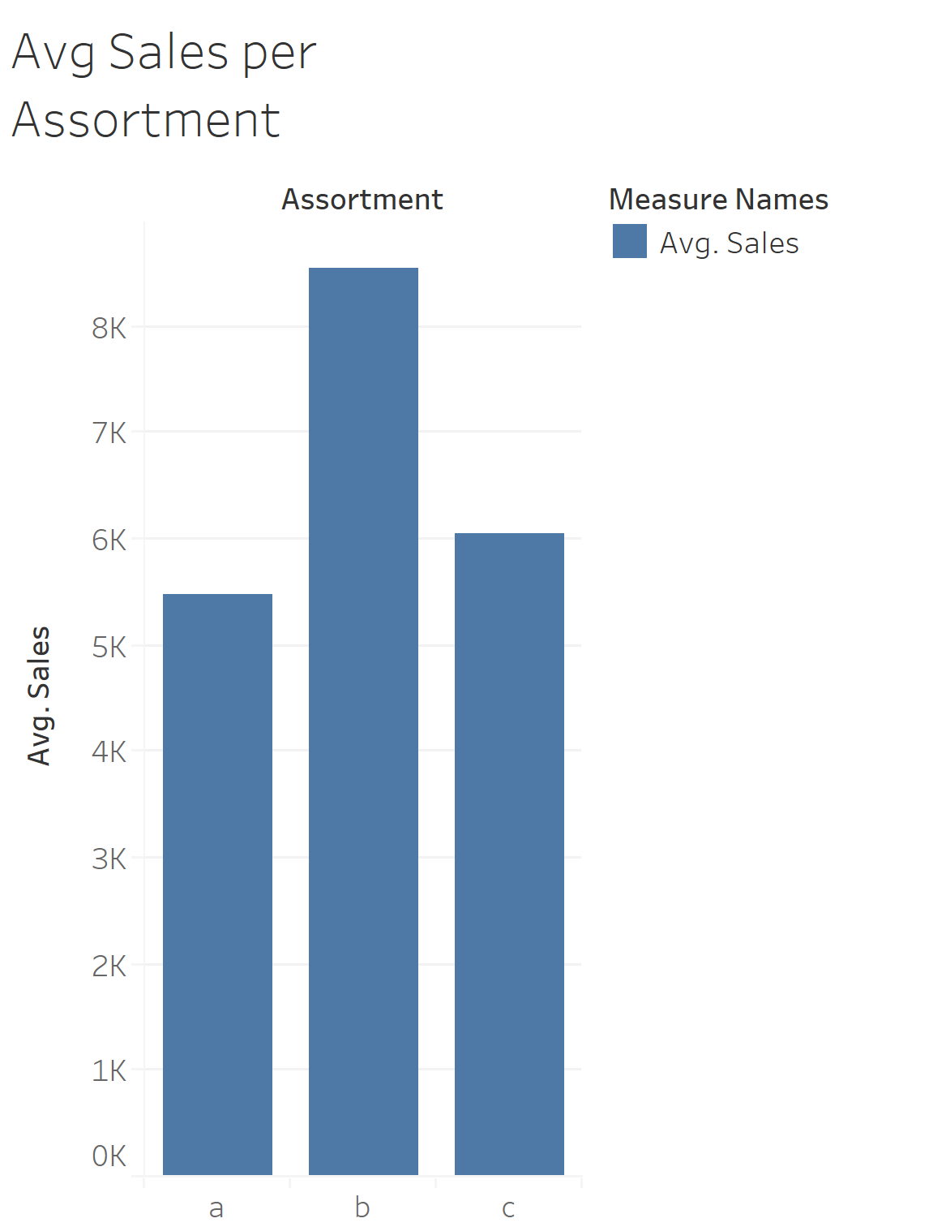
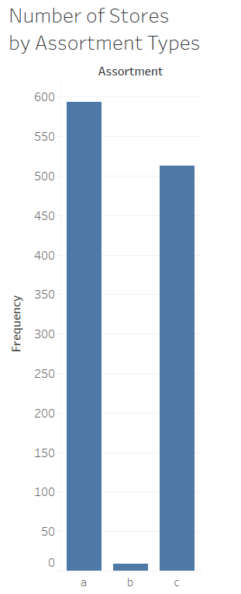
Store Assortment
Avg Sales Per Assortment
Num. of Stores by Assortment Types
Assortment: a=basic, b=extra, c=extended
Overall more sales generated in “extra” assorted stores
“Extra” stores are least common, however

Slide 15
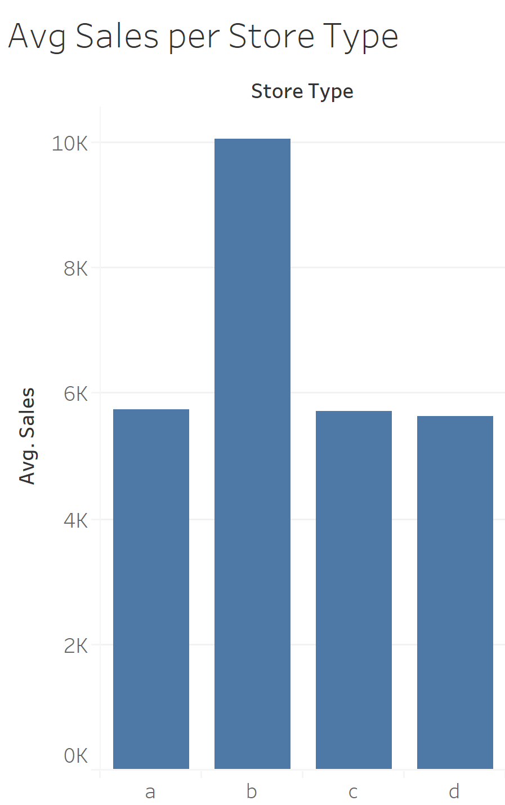


Store Type
Type B Stores have almost $4,000 more in average sales, about 67% more than the other store types.
Based on previous insights, we want to include these variables into our model:
Time-series elements: months, day of the week
Holidays
Store assortments
Store types

Slide 16
Data Preparation

Slide 17



Data Prep Process
Clean Data
Create Variables
Manipulate Data
Dealing with missing value
1. Replace missing value with 0’s in “competition” and “promotion” with assumptions that those stores lack such events or competitors
2. Created a 1/0 column to indicate missing values for “competition days since”, “promo2 days since”
Seasonality
Create week of month/month/year variables to capture seasonality from Sales Date
New time variables
Create variables to record the number of days since the last competition/promotion as these are more useful than just promo/competition month/year variables.
Cut off date for Days calculation is Sept 2015 (Kaggle Competition Date)
Dummy Variables
Encode dummy variables for categorical columns
Standardize
Standardize features by finding the mean and scaling to unit variance for certain models like KNN
Transformation:
Log: “Competition days since”
Sqrt: “Customers” and “promo days”
Split train/test:
Train data: Jan 2013- Dec 2014
Test data: Jan- July 2015

Slide 18
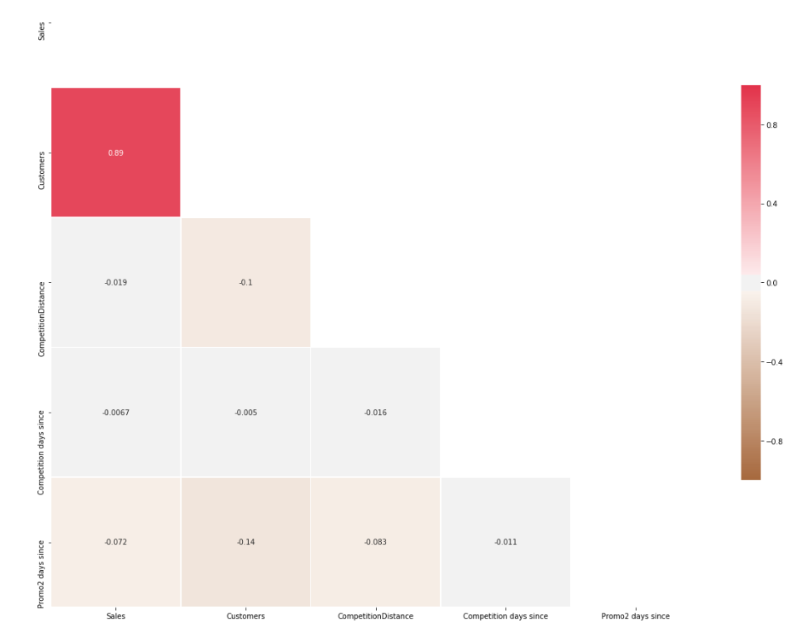

Data Leakage Consideration
“Customers” is highly correlated with sales (correlation = 0.89)
BUT
We won’t know the number of customer when making prediction on unseen data
Data Leakage: Customer #

Slide 19
Approaches for Data Leakage
1
2
Drop “Customers” Column
Predict “Customers”
Result:
MAE increases
RMSE doubles
Above justifies fact that Sales is a function of Customers Visited so variable is needed in model
Predict the number of customers first and then use the predicted number to predict sales
Build two models: one for predicting“Customers”, one for “sales”
Better Result

Slide 20

Modeling Overview

Slide 21
Modeling Process Overview
Pre processing Techniques
Model training
Model Methods
Measure of Performance
- Standardization
- Stepwise Variable selection
-Power Transformations
- Split train/test data using date:
Train data: Jan 2013- Dec 2014
Test data: Jan - July 2015
- Train size: 780k (76%)
Test size: 236k (24%)
- Non linear models utilized grid search with 5 fold cross validation for parameter tuning
- Linear Regression
- Ridge
- Lasso
- Elastic net
- KNN
- Decision Tree
- Random Forest
- Gradient Boosting
- RMSE
- MAE

Slide 22
Model Results - Predicting Customers
Modeling Approach | Std Data | Transform | Grid Search | Stepwise | MAE | RMSE
Linear Regression | - | - | - | - | 194.20 | 288.12
Linear Regression | Y | - | - | - | 324.19 | 470.83
Linear Regression | - | Y | - | - | 193.44 | 282.78
Linear Regression | - | - | - | Y | 194.20 | 288.12
Linear Regression | - | Y | - | Y | 192.65 | 280.92
K Nearest Neighbors | Y | - | Y | - | 91.87 | 160.45
Decision Trees | - | - | Y | - | 186.36 | 287.35
Random Forest | - | - | Y | - | 147.39 | 159.39
Gradient Boosting | - | - | Y | - | 61.37 | 101.12
Gradient Boosting | - | - | Y | Y | 58.3 | 97.59
Ridge/Lasso | - | - | Y | - | 194.18 | 288.10
Elastic net | - | - | Y | - | 194.06 | 288.06

Slide 23
Model Results - Predicting Sales
Modeling Approach | Std Data | Transform | Grid Search | Stepwise | MAE | RMSE
Linear Regression | - | - | - | - | 867.73 | 1217.34
Linear Regression | Y | - | - | - | 868.2 | 1223.92
Linear Regression | - | Y | - | - | 849.12 | 1161.91
Linear Regression | - | - | - | Y | 918.89 | 1308.57
Linear Regression | - | Y | - | Y | 909.29 | 1207.93
K Nearest Neighbors | Y | - | Y | - | 588.55 | 941.73
Decision Trees | - | - | Y | - | 1035.94 | 1547.48
Random Forest | - | - | Y | - | 802.57 | 1044.39
Gradient Boosting | - | - | Y | - | 312.96 | 493.72
Gradient Boosting | - | - | Y | Y | 312.64 | 494.43
Ridge/Lasso | - | Y | Y | - | 848.91 | 1161.97
Elastic net | - | Y | Y | - | 846.73 | 1162.67

Slide 24
Evaluation and Deployment

Slide 25


Model Evaluation
We chose the model with the best RMSE
Final Model:
Gradient Boosting + Grid Search
RMSE has the benefit of penalizing large errors more so can be more appropriate since we want to keep the prediction as close as possible to the actual value and avoid under forecasting and over forecasting
Notes:
Evaluation (15 points)
· Discuss how the result of the data mining is/should be evaluated. How should a business case be developed to project expected improvement? ROI? If this is impossible/very difficult, why and is there a viable alternative?

Slide 26
Business Case Considerations/Deployment
Revenue Growth
Sales Target
Regional Difference
Cash Flow
The client would be able to forsee how each store is operating with the sales prediction and develop promotion strategy accordingly for revenue growth
Forecasting sales will help the client set the sales target quota and plan resources for each store accordingly
Forecasting sales for stores would help the client to better understand the regional difference and better shape corporate strategy in terms of store expansion and closing decisions
The client will be able to project cash flows and foresee which stores might need support and which stores can function without monetary support.

Slide 27
Potential Risks
Over Forecasting
Under Forecasting
New Store Types
Unexpected Condition
Over forecasting will lead to a potential failure of the sales team in meeting the targets and the client might not be able to meet seasonal goal for revenue
Under forecasting will make the sales targets very easy to achieve and cause loss for the company
Since the model relies on historical data, it will not able to predict the sales for a store with different store attributes due to the lack of historical data
The model doesn’t include weather, disaster, or pandemic factors, which would have severe impacts on sales.

Slide 28
Questions?

Slide 29
Appendix

Slide 30
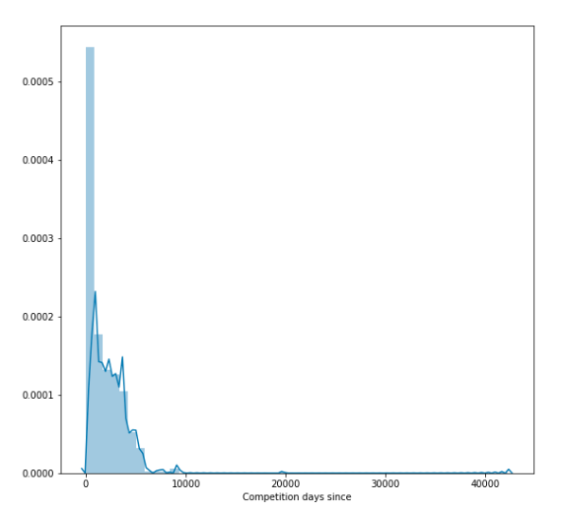
Continuous Variable Distributions

Slide 31
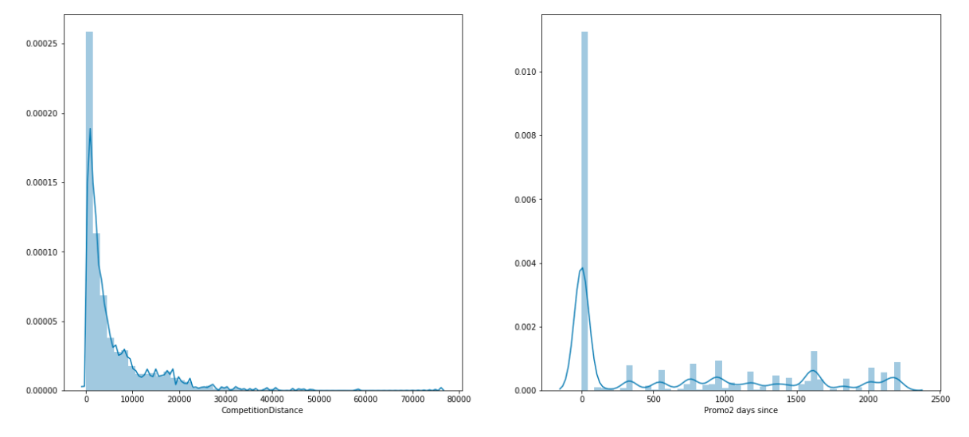
Continuous Variable Distributions

Slide 32
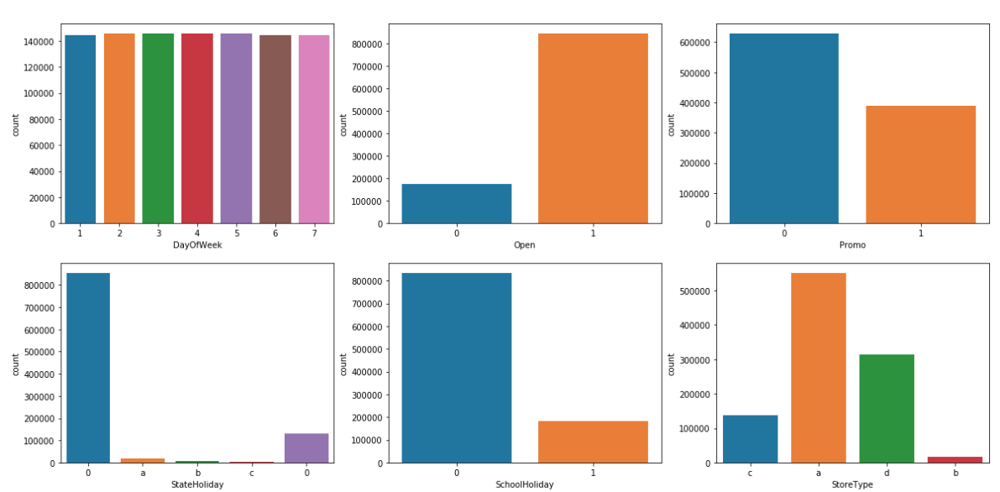
Categorical Variable Distributions

Slide 33
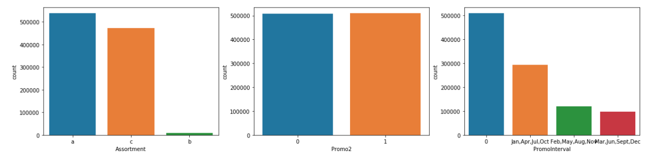
Categorical Variable Distributions

